Slide 1




Diversified Top-k Graph Pattern Matching
Wenfei Fan
Xin Wang
Yinghui Wu
University of Edinburgh
Southwest Jiaotong University
UC Santa Barbara

Slide 2

Graph pattern matching in social search
Graph pattern matching in social networks
Applications: social relationship search, social role analysis, expert search, etc.
Social graphs are typically large, with billions of nodes and edges.
Challenges
Costly over large social networks;
Matching algorithms return too many results;
“query focus” in social network queries
These motivate us to find best matches of the specific pattern node via graph pattern matching. However the problems are challenging!
Notes:
Graph pattern matching is one of the most fundamental techniques for social network analysis, its typical applications include social relationship search, social role analysis, expert search, etc.
While as social graphs are typically very Large: with billions of nodes and edges, (e.g., Facebook, Twitter, Linkedin), hence it is often very challenging to conduct graph pattern matching on large graphs.
Specifically, there are three main Challenges: (1) The first one is that graph pattern matching is computationally expensive, e.g, it is O(|G||Q|+|G|2) time for graph pattern matching via simulation, and exponential time for graph pattern matching with subgraph isomorphism; (2) secondly, it returns too many matches, e.g., there are O(|G||Q|) matches for graph simulation, and exponential many matches for subgraph isomorphism; (3) thirdly, one may often want to find matches of a specific pattern (query) node uo as “query focus”, rather than the entire set (match set) M(Q;G) of matches of Q.
Real-life social networks often consist of nodes and edges with multiple types. For example, nodes in Twitter represent users or blogs, and edges indicate different relationships, e.g., edge from user u1 to user u2 indicates that u1 follows u2, while edge from user u1 to blog B denotes that u1 tweets blog B

Slide 3
Hardness of the problems
Top-k graph pattern matching problem
Complexity: O(|G||Q| + |G|²) time with early termination.
Diversified top-k graph pattern matching problem
Complexity:
NP-complete;
2-approximable in O((|Q||G|+|V|(|V|+|E|)) time;
“Early termination” heuristic algorithm in O((|Q||G|+|V|(|V|+|E|)) time.
Approximating Diversification
2-approximable algorithm
Idea: rounding down diversification function and reduce to Maximum dispersion.
Early termination heuristics
Idea: greedily select new matches that maximizes the difference with selected matches.
Notes:
We study the top-k graph pattern matching problem, which are hard to solve.
Let’s see the hardness of the problems.
For top-k graph pattern matching, it is in Quadratic time.
While Diversified top-k problem is hard, NP-complete (reduced from K-diverse set)
When letting \lambda = 1, it is special case includes K-diverse set instance, which is already NP-complete.
Hence, we develop approximation algorithm with Approximation ratio 2, where 2-approximable is proved by reduction from Maximum Dispersion problem.
We also develop heuristic algorithm with early termination property.
The problem MAXDISP is to find a subgraph G’c induced by a k-node set Vc from a weighted complete graph Gc, with the maximum sum of node and edge weights.

Slide 4






Finding best candidates
complete matching relation
(project manager, PM₁), (project manager, PM₂)
(project manager, PM₃), (project manager, PM₄)
(programmer, PRG₁), (programmer, PRG₂)
(programmer, PRG₃), (programmer, PRG₄)
(DBmanager, DB₁), (DBmanager, DB₂)
(DBmanager, DB₃)
(tester, ST₁), (tester, ST₂)
(tester, ST₃), (tester, ST₄)
When graph pattern matching is defined in terms of subgraph Isomorphism, no match of Q can be identified in G, since it is too restrictive to define matches as isomorphic subgraphs.
Query: find good PM (project manager)
candidates collaborated with
PRG (programmer), DB (database developer)
and ST (software tester).
We adopt to find matches using graph simulation, which computes a binary relation on the pattern
nodes in Q and their matches in G.
Project
Manager*
“query focus”
PM₁
PM₂
PM₃
PM₄
Programmer
DB manager
BA
PRG₁
DB₁
PRG₄
DB₂
PRG₃
DB₃
Tester
Pattern graph Q
UD₁
ST₁
ST₂
ST₃
UD₂
PRG₂
ST₄
Collaboration network G
Notes:
Since graph pattern matching has many semantics, e.g., subgraph isomorphism and graph simulation, in our work, we advocate to use graph simulation as it is more sensitive to find meaningful matches compared with other semantics and in addition, it has lower time complexity.
Below let’s look at one example.
When graph simulation is used, the match result is a binary relation, where PM has matches, PM1 to PM4, and ….
A company issues a graph search query to find PMs who
supervised both DBs and PRGs, and moreover, (1) the DB
worked under the PRG directly or indirectly, and vice versa;
and (2) both the DB and the PRG supervised an ST.
The requirements for the PMs are expressed as a graph pattern
Q shown in Fig. 1 (a). Here PM is the “focus” of the
query, i.e., only the matches of PM are asked for. This is
indicated by labeling PM with ‘∗’ as the “output node” of Q.

Slide 5




Problem formalization
Graph pattern matching using simulation (VLDB 10)
a graph G matches a pattern P if there exists a matching relation S;
for each pair (u, v) in S, v is a node in G that matches u in P;
for each edge (u, u’) in P, there exists an edge (v, v’) in G and (u’, v’) is in S.
Graph pattern matching revised
extend a pattern with a designated output node u₀
matches Q(G): the matches of u₀
readily extends to multiple output nodes
Problem: we want to find (diversified) top-K matches for graph pattern matching with a designated output node.
(PM₁-PM₄) in the example
Project
Manager*
Programmer
DB manager
Tester
Notes:
Let’s recall the definition of graph simulation
Based on the traditional definition, we revise it by extending a pattern with a designated output node uo, with the extension we find matches of uo only, rather than the entire matching relation. Moreover, multiple output nodes can be assigned on the pattern.

Slide 6
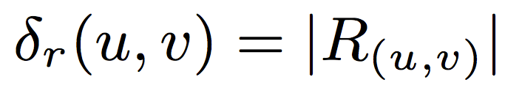
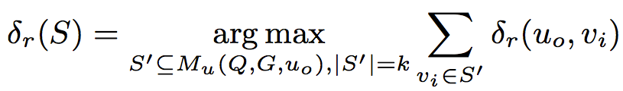
Top-k matching problem
Relevance
Relevant set R(u,v) for a match v of a query node u:
all descendants of v as matches of descendants of u
a unique, maximum relevance set
Relevance function
The more reachable matches, the better
Top-k matching: find top-k match set that maximizes total relevance
PM₂
PRG₄
DB₂
PRG₃
DB₃
ST₂
ST₃
PRG₂
ST₄
Notes:
We first study top-k matching problem.
As there may exist a large number of matches of output node and users are often interested in best k matches, then, we should define certain function to rank matches. To this end, we propose a ranking function based on “social impact”.
Specifically, we measure how relevant a match v to the query node u, by its relevant set, which includes all the descendants of v as matches of descendants of u.
As observed in our example, PM2 has its relevant set with 8 descendants as matches of descendants of PM.

Slide 7
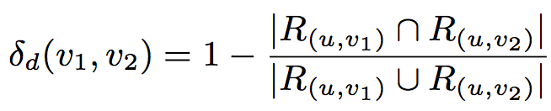


Match Diversification
Match diversity
Diversity function: set difference of the relevant set
Diversification: a bi-criteria combination of both relevance and diversity
relevance: common neighbors, Jaccard coefficient…
diversity: neighborhood diversity, distance-based diversity
Diversified Top-k Matching: find a set S of matches for output node s.t
Notes:
Since it is very important to diversify search results, we define a diversity function based on jaccard distance to measure the “dissimilarity”of two matches.
Then based on both relevance and diversity, we define the diversification function on a match set S of the output node uo. The function F(S) is defined as, where the parameter \delta_r’(uo, vi) is the normalized function, by dividing \delta_r(uo,vi) with C_{u_o}, which includes all the candidates. Parameter \lambda is used to tune importance of relevance or dissimilarity.
It is worth mentioning that users can use other relevance and diversity metrics to define diversification function.
The diversity metric is scaled down with 2*\lambda/(k−1), since there are k*(k−1)/2 numbers for the difference sum, while only k numbers for the relevance sum
We can generalize relevance and diveristy functions by using common neighbors, Jaccard coefficient and neighborhood diversity, distance-based diversity.

Slide 8
Finding Top-k Matches (for Acyclic Patterns)
Finding Top-k matches for acyclic patterns
Initializes a heap S, and a vector for each candidate v
Computes a set of matches for some query nodes (can be determined without following steps)
Iteratively updates vectors of other candidates by propagating the partial answers
Termination condition:
(1) each v in S is a match of uo, and
(2) minv∈S(l(uo, v)) ≥ maxv′∈can(uo)\S(h(uo, v)), where
l(uo, v) and h(uo, v) denote a lower bound and upper bound of r(uo, v).
xXv: match?
v.R: relevance set
v.lower, v.upper: relevance bound
Notes:
We now introduce topk matching algorithm for acyclic patterns. Specifically, the algorithm works following the steps.
The naive solution works like this: 1) find all matches, 2) ranking, 3) pick top-k
We develop new algorithms which has “early termination” property.

Slide 9




Finding Top-k Matches (for Acyclic Patterns)
Project
Manager*
PM₁
PM₂
PM₃
PM₄
PRG₁
DB₁
PRG₄
DB₂
PRG₃
DB₃
BA
Starting propagation from DB2, after propagation, parts of the vectors are as below.
After initialization, vectors of parts nodes.
Programmer
DB manager
UD₁
ST₁
ST₂
ST₃
UD₂
PRG₂
ST₄
v | v.T = <v.bf, v.R, v.l, v.h>
PM1 | <XPM1 = XPRG1 ˄ XDB1, Ф, 0, 2>
PM2 | <XPM2 = ((XPRG3 =true) V (XPRG4=true)) ˄ XDB2=true, {DB2, PRG4, PRG3}, 3, 3>
PM3 | <XPM3 = (XPRG3 = true) ˄ (XDB2=true), {DB2, PRG3}, 2, 2>
PM4 | <XPM4 = (XPRG3 = true) ˄ XDB3, Ф, 0, 2>
PRG1 | <XPRG1 = XDB1, Ф, 0, 1>
PRGj (j ∈ [3,4]) | <XPRGj = true, {DB2}, 1, 1>
DB2 | <XDB2 = true, Ф, 0, 0>
DBk (k ∈ [1,3]) | <XDBk = true, Ф, 0, 0>
v | v.T = <v.bf, v.R, v.l, v.h>
PM1 | <XPM1 = XPRG1 ˄ XDB1, Ф, 0, 2>
PM2 | <XPM2 = (XPRG3 V XPRG4) ˄ XDB2, Ф, 0, 3>
PM3 | <XPM3 = XPRG3 ˄ XDB2, Ф, 0, 2>
PM4 | <XPM4 = XPRG3 ˄ XDB3, Ф, 0, 2>
PRG1 | <XPRG1 = XDB1, Ф, 0, 1>
PRGj (j ∈ [3,4]) | <XPRGj = XDB2, Ф, 0, 1>
DBk (k ∈ [1,3]) | <XDBk = true, Ф, 0, 0>
PM2 is verified to be a valid match, and its relevant set includes {DB2, PRG4, PRG3}, which is the largest relevant set compared with other PMs.
Early termination condition is met.
Notes:
PM1, PM3 and PM4 do not need to check.

Slide 10
Finding Top-k Matches (for Cyclic Patterns)
Finding Top-k matches for cyclic patterns
Computes topological rank r(u) of query nodes u in Q;
Iteratively updates vectors of candidates by propagating the partial answers if the corresponding uscc contains only one node;
Otherwise, employs Procedure SccProcess to verify matches.
Project
Manager*
Project
Manager*
r(PM) = 2
r(uscc) = 1
Programmer
DB manager
Programmer
DB manager
Tester
r(ST) = 0
Tester
Notes:
The topological rank r(v) of a node v in G is defined as (a)
r(v) = 0 if v_SCC is a leaf in G_SCC (i.e., with outdegree 0), and
otherwise, (b) r(v) = max{(1+r(v′)) | (v_SCC; v_SCC) ∈ E_SCC}.
Now let’s look at how the topological rank is defined. Given such a pattern Q, its dag graph contains only 3 nodes and 2 edges.

Slide 11




Finding Top-k Matches (for Cyclic Patterns)
Project
Manager*
PM₁
PM₂
PM₃
PM₄
PRG₁
DB₁
PRG₄
DB₂
PRG₃
DB₃
BA
Programmer
DB manager
Tester
UD₁
ST₁
ST₂
ST₃
UD₂
PRG₂
ST₄
Start propagation from ST3 and ST4
v | v.T = <v.bf, v.R, v.l, v.h>
PM1 | <XPM1 = XPRG1 ˄ XDB1>, Ф, 0, 4>
PM2 | <XPM2 = (XPRG3 V XPRG4) ˄ XDB2, Ф, 0, 8>
PM3 | <XPM3 = (XPRG3 ˄ XDB2), Ф, 0, 6>
PM4 | <XPM4 = (XPRG3 ˄ XDB3), Ф, 0, 6>
PRG2 | <XPRG1 = XDB3 ˄ true, Ф, 0, 6>
PRG3 | <XPRG1 = XDB2 ˄ true, Ф, 0, 6>
PRG4 | <XPRG4 = XDB2 ˄ true, Ф, 0, 7>
DB2 | <XDB2 = XPRG2 ˄ true, Ф, 0, 6>
DB3 | <XDB3 = XPRG3 ˄ true, Ф, 0, 6>
PM2 and PM3 are top-2 matches, since we can determine their relevance sets are largest two sets.
XPM2=true
XPM3=true
XPM3=true
XPRG2=true
The algorithm can terminate early, although PM2 has another descendant ST2 which is also a true match of ST and PM1 is not verified at all.
XPRG3=true
XPRG4=true
XDB2=true
XDB3=true
Notes:
Start propagation from ST3 and ST4. whose scc node contains a single node.
Then the propagation reaches nodes whose corresponding pattern nodes form a strongly connected component. Now we use a procedure to verify whether those matches are true matches or not.
PM2 has one more match than PM3.

Slide 12
Finding Top-k Diversified Matches
V | R(uo, v) | δr ()
PM1 | {PRG1, DB1, ST1, ST2} | 4
PM2 | {PRG4, PRG3, PRG2, DB2, DB3, ST2, ST3, ST4} | 8
PM3 | {PRG3, PRG2, DB2, DB3, ST3, ST4} | 6
PM4 | {PRG3, PRG2, DB2, DB3, ST3, ST4} | 6
δd () | PM1 | PM2 | PM3 | PM4
PM1 | 0 | 10/11 | 1 | 1
PM2 | 10/11 | 0 | 1/4 | 1/4
PM3 | 1 | 1/4 | 0 | 0
PM4 | 1 | 1/4 | 0 | 0
PM1 and PM3 are picked by TopKDiv as
top-2 diversified matches.
PM₁
PM₃
F() | PM1 | PM2 | PM3 | PM4
PM1 |  | 1.45 | 1.45 | 1.45
PM2 | 1.45 |  | 0.89 | 0.89
PM3 | 1.45 | 0.89 |  | 0.55
PM4 | 1.45 | 0.89 | 0.55
PRG₁
DB₁
DB₂
PRG₃
DB₃
F’(PM1, PM3)=0.5*(4/11+6/11) + 1 = 1.45
ST₁
ST₂
ST₃
PRG₂
ST₄
PM1 and PM3 have no descendant matches in common, and influence a large part of the matches.
Notes:
2-approximable algorithm:
1) Compute all the matches, δr() and δd();
2) Iteratively find two matches v1, v2,
such that F’(v1, v2) is maximized;
If k is odd, then in the last round, we randomly pick a match

Slide 13
Finding Top-k Diversified Matches
PM₁
PM₂
PM₃
PM₄
PRG₁
DB₁
PRG₄
DB₂
PRG₃
DB₃
BA
UD₁
ST₁
ST₂
ST₃
UD₂
PRG₂
ST₄
PM2 and PM3 are picked by TopKDH as
top-2 diversified matches.
PM2,PM3,PM4 are verified true matches, and the termination condition is satisfied.
v | v.T = <v.bf, v.R, v.l, v.h>
PM1 | <XPM1 = XPRG1 ˄ XDB1>, Ф, 0, 4>
PM2 | <XPM2 = (XPRG3 V XPRG4) ˄ XDB2, {PRG4, PRG3, PRG2, DB2, DB3, ST3, ST4} , 7, 8>
PM3 | <XPM3 = (XPRG3 ˄ XDB2), {PRG3, PRG2, DB2, DB3, ST3, ST4}, 6, 6>
PM4 | <XPM4 = (XPRG3 ˄ XDB3), {PRG3, PRG2, DB2, DB3, ST3, ST4}, 6, 6>
F’’(PM2, PM3)=(1-0.1) * (7/11+6/11) + 2*0.1*/(2-1) * 1/7 = 1.1
Notes:
Early termination heuristic
We start propagation from S3 and S4;
When the propagation reaches match candidates, we compute function F’(), and pick the best matches.
Once termination condition is reached, the algorithm terminates, and returns best matches.

Slide 14
Experimental evaluation
Dataset
Real-life graphs
Synthetic graphs
Amazon EC2 Instance with 3.75GB memory, 2 EC2 compute unit.
Algorithms
Top-k matching (with/without optimization)
Brute force algorithm
Diversified algorithm: Approximation & Heuristic with early termination
Graphs | |V| | |E|
Amazon co-purchasing network | 548,552 | 1,788,725
Citation | 1,397,240 | 3,021,489
Youtube | 1,609,969 | 4,509,826
Notes:
The “wh” nodes in knowledge querying for knowledge graphs

Slide 15
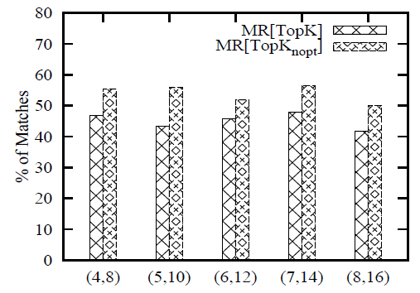
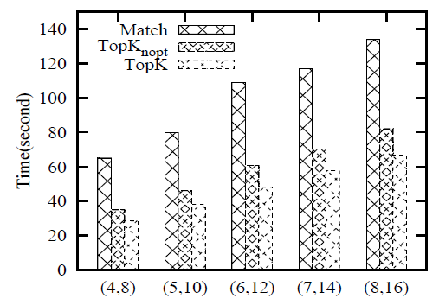
Experimental evaluation
Varying |Q| on Youtube
Notes:
Nopt algorithm is the naive algorithm, randomly pick initial propagation nodes.
We find that when our algorithms terminate, topK finds about 45% matches of brute force algorithm Match, and with opt has better performance than without opt.
In addtion, Topk takes 52% of the time used by Match, which is consistent with the number of matches found.

Slide 16
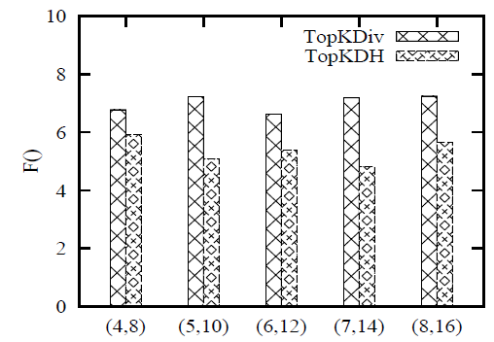
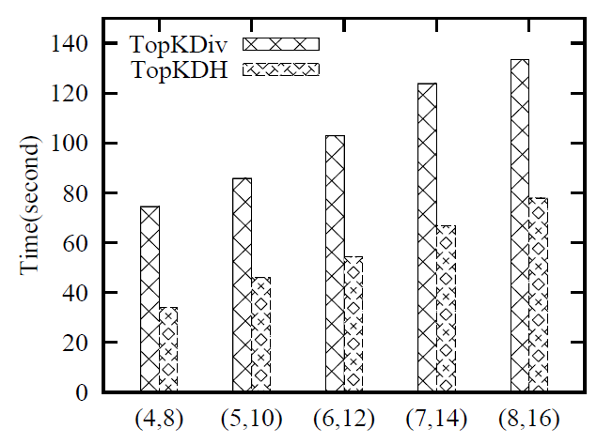
Experimental evaluation
Varying |Q| on Amazon
Varying |Q| on Youtube
Notes:
On amazon, we find that TopKDiv finds matches with higher F() value, that’s it finds matches nearer optimal results.
While TopKDH has lower F(), but we also find that TOPKDH uses much less time to find matches, only about 50% of the time.

Slide 17
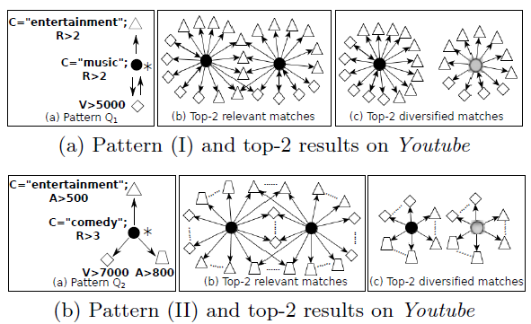
Experimental evaluation
Notes:
We investigated our query results and found two sets of matches on Youtube graph.

Slide 18
Conclusion && Future work
Conclusion
revised graph patterns by supporting a designated output node;
defined functions to measure match relevance and diversity, as well as a bi-criteria objective function based on both;
algorithms for computing top-k matches, and for finding diversified top-k matches, with properties such as constant approximation ratios and early termination;
verified effectiveness of our methods.
Future work
Optimization techniques to further reduce the number of matches examined by our algorithms;
Distributed top-k matching algorithms on graphs that are partitioned, distributed and possibly compressed.

Slide 19
Thanks!

